Slide 1
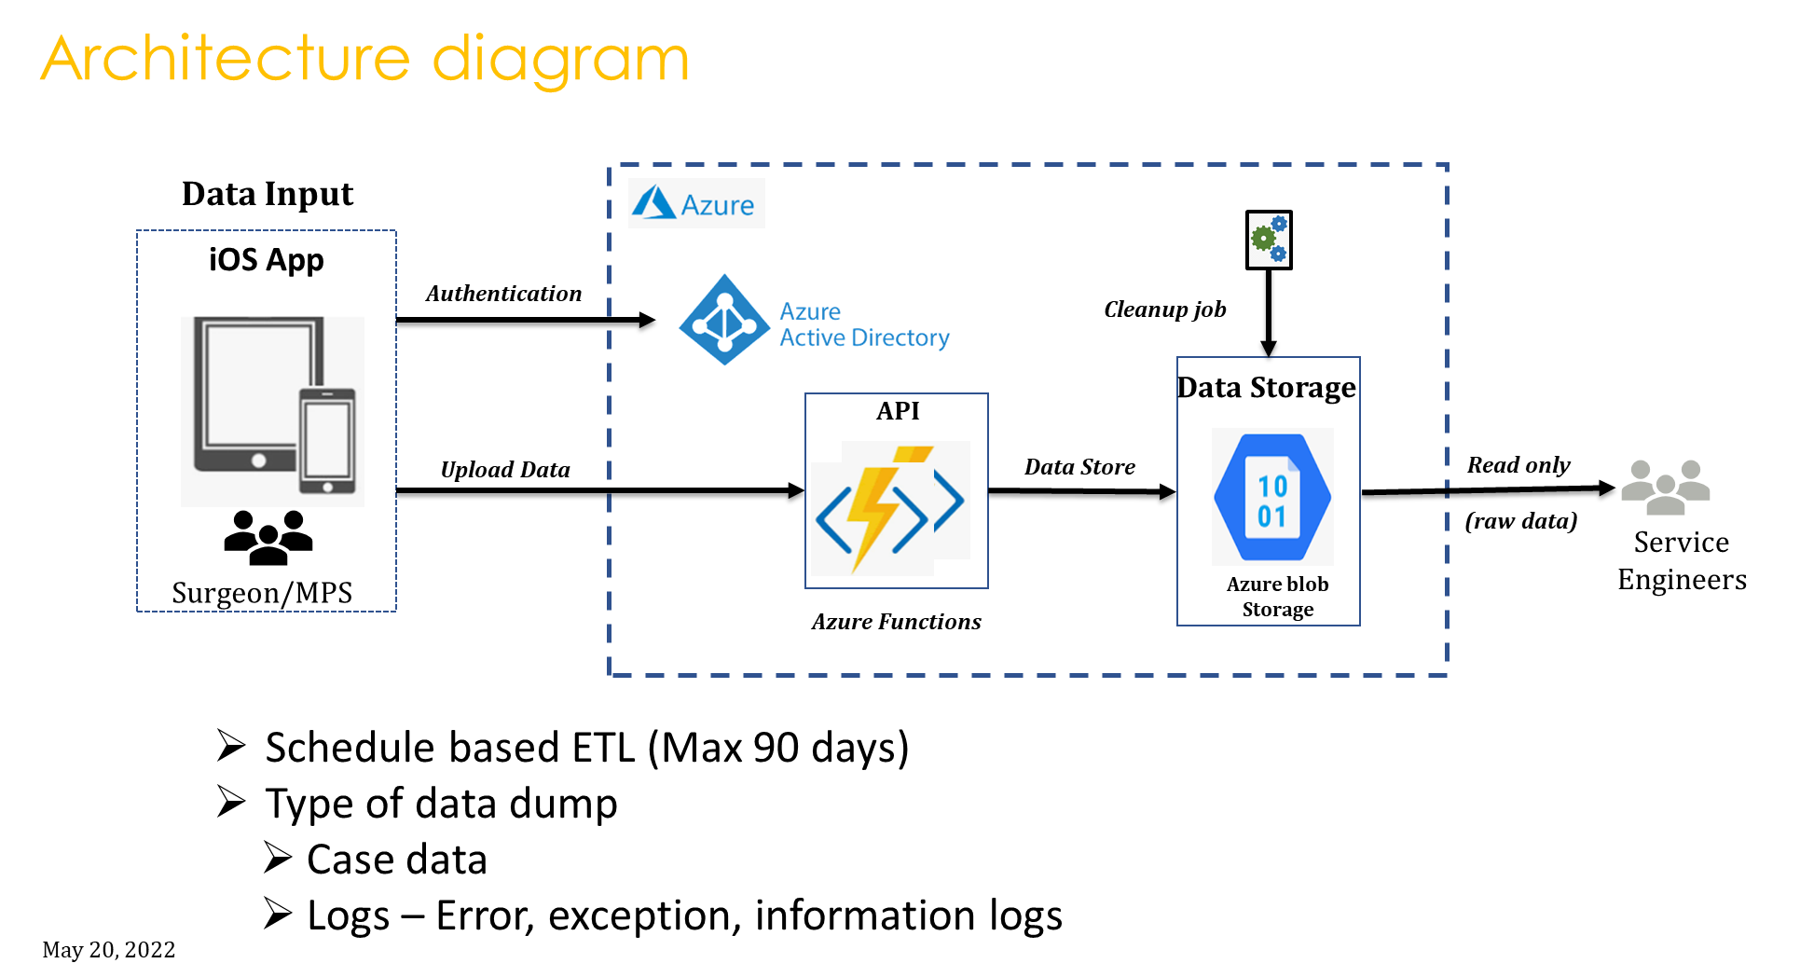

Slide 2

Sequence diagram : Azure Storage (File service)
BLob
KB App
MPS User
Azure AD
Azure Storage Acc
Initiate Upload
request
Authentication
Authentication Grant
Upload Request (Json File)
https Put
Store File(Json)
File Stored
https Response
Https Response 201

Slide 3
Azure storage is a feature of Microsoft Azure. It allows users to store large amounts of unstructured data on Microsoft’s data storage platform.
.
The REST APIs for storage services expose the storage account as a resource.
The Azure storage services support both HTTP and HTTPS; however, using HTTPS is highly recommended.
Data in Azure Storage is encrypted and decrypted transparently using 256-bit AES encryption.

